Slide 1
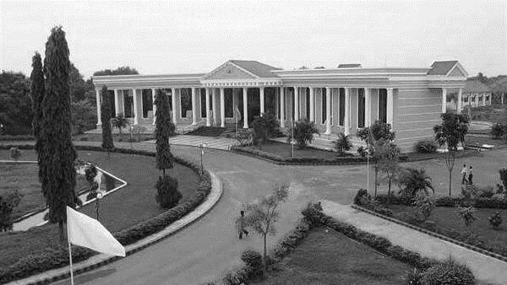




“MULTIMODAL AI–DRIVEN SMART HEALTHCARE PLATFORM FOR INTELLIGENT TELEMEDICINE AND DIAGNOSTIC DECISION SUPPORT”
PRESENTED BY :
Kesavan. R - [510422205027]
Purushothaman. S - [510422205302]
Janamejan. V - [510422205020]
Syed Adhil B - [510422205056]
DEPARTMENT OF IT
PROJECT GUIDE
Mrs. K. Haripriya,
AP/IT.

Slide 2
PROBLEM STATEMENT
Lack of transparency reduces trust in AI systems.
Systems are not user-friendly for elderly and disabled users.
No proper emergency detection for critical conditions.
Patients face high costs due to unnecessary tests.
Absence of integrated healthcare solutions in a single platform.

Slide 3
INTRODUCTION
The project presents an AI-driven smart healthcare platform that functions as a digital hospital.
It enables multimodal interaction (voice and text input) for better accessibility.
The system provides instant disease prediction with emergency alerts for critical cases.
It is designed as a scalable solution for future integration with hospitals and telemedicine services.

Slide 4
ABSTRACT
The completed modules include voice-based input, an AI-driven disease prediction system, and SHAP-based visualization for explainable results, all integrated with a fully functional frontend, backend, and cloud deployment. The remaining work focuses on implementing OCR for medical report scanning and a doctor recommendation system to enhance user support. In the future, the system will include video consultation and digital health records, with a modular design that allows easy addition of new features and scalability.

Slide 5
OBJECTIVE
Develop an accurate AI model for disease prediction.
Implement Explainable AI for transparency.
Enable voice and text-based interaction.
Reduce healthcare costs and unnecessary tests.
Provide integrated and user-friendly healthcare system.

Slide 6
EXISTING SYSTEM
Only supports text-based symptom input.
Provides no explanation for predictions.
Lacks emergency alert mechanisms.
Healthcare services are fragmented across multiple apps.
Does not support traditional medicine systems.

Slide 7
PROPOSED SYSTEM
Introduces voice-enabled symptom input system.
Uses SHAP for Explainable AI visualization.
Includes real-time emergency detection system.
Applies intelligent follow-up questioning for better accuracy.
Provides treatment recommendations across multiple medical systems.

Slide 8
TOOLS AND TECHNOLOGIES
Frontend: Tailwind CSS, JavaScript, React.js Web Speech API.
Backend: Python and Flask framework.
AI Tools: Scikit-learn, Pandas, SHAP.
Deployment: Render, Gunicorn, GitHub.
Development supported by VS Code and virtual environments.

Slide 9
DATASET DESCRIPTION
Contains 130+ symptoms and 40+ diseases.
Collected from Kaggle medical datasets.
Includes disease descriptions and precaution details.
Supports extension with new diseases and treatments.
Helps in accurate mapping between symptoms and diseases

Slide 10
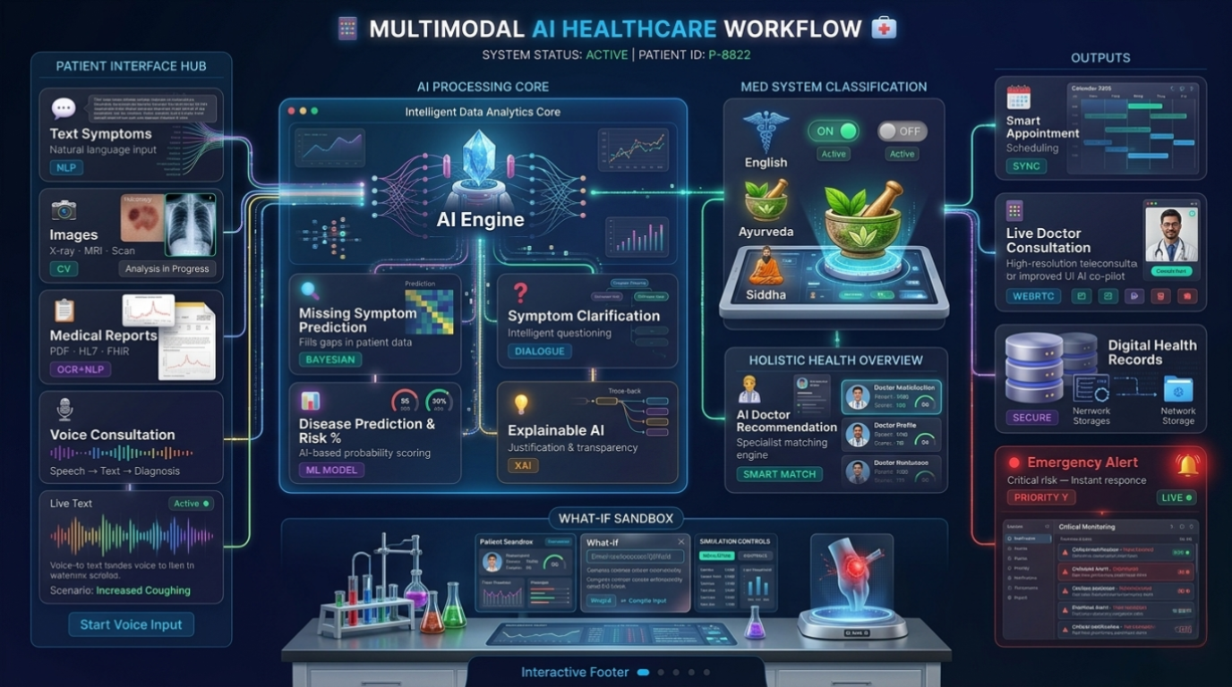
SYSTEM AECHITECTURE

Slide 11
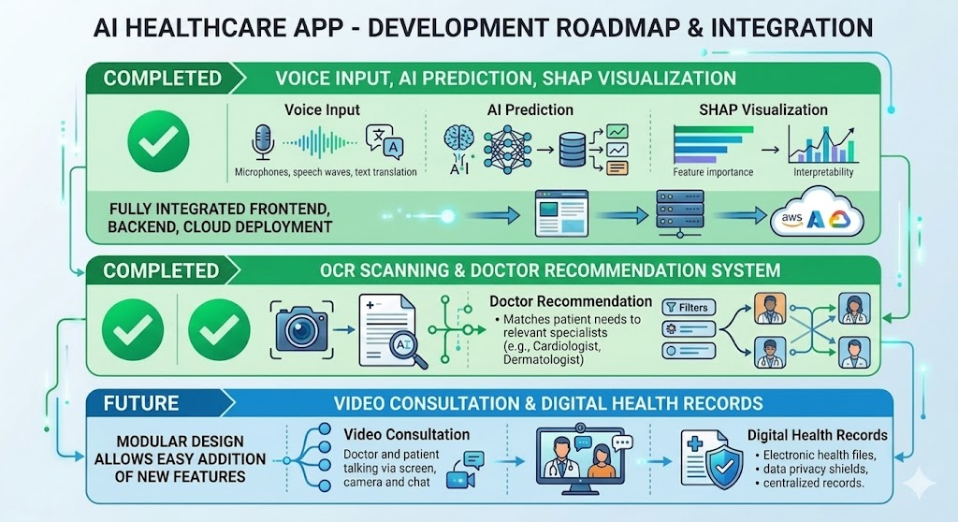
MODULES

Slide 12
EXPECTED OUTCOME
Provides easy-to-use healthcare platform for all users.
Improves trust with explainable AI results.
Enables early detection of critical diseases.
Reduces medical expenses and unnecessary tests.
Enhances overall healthcare accessibility and efficiency.

Slide 13
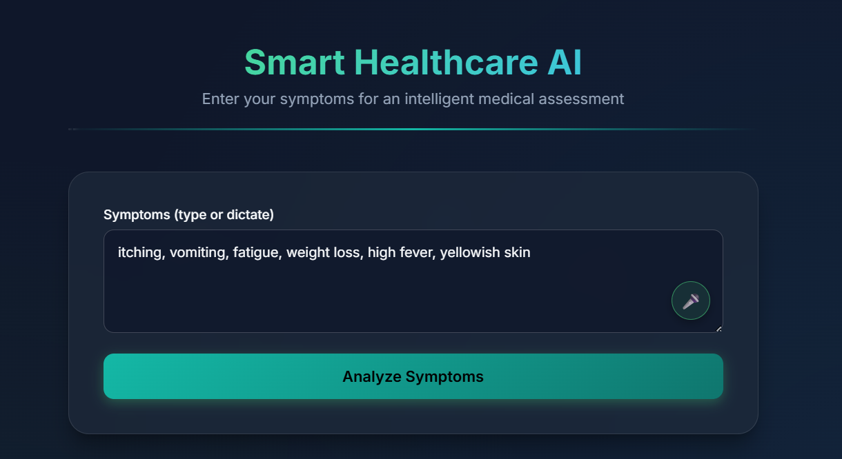
SAMPLE IMAGES

Slide 14
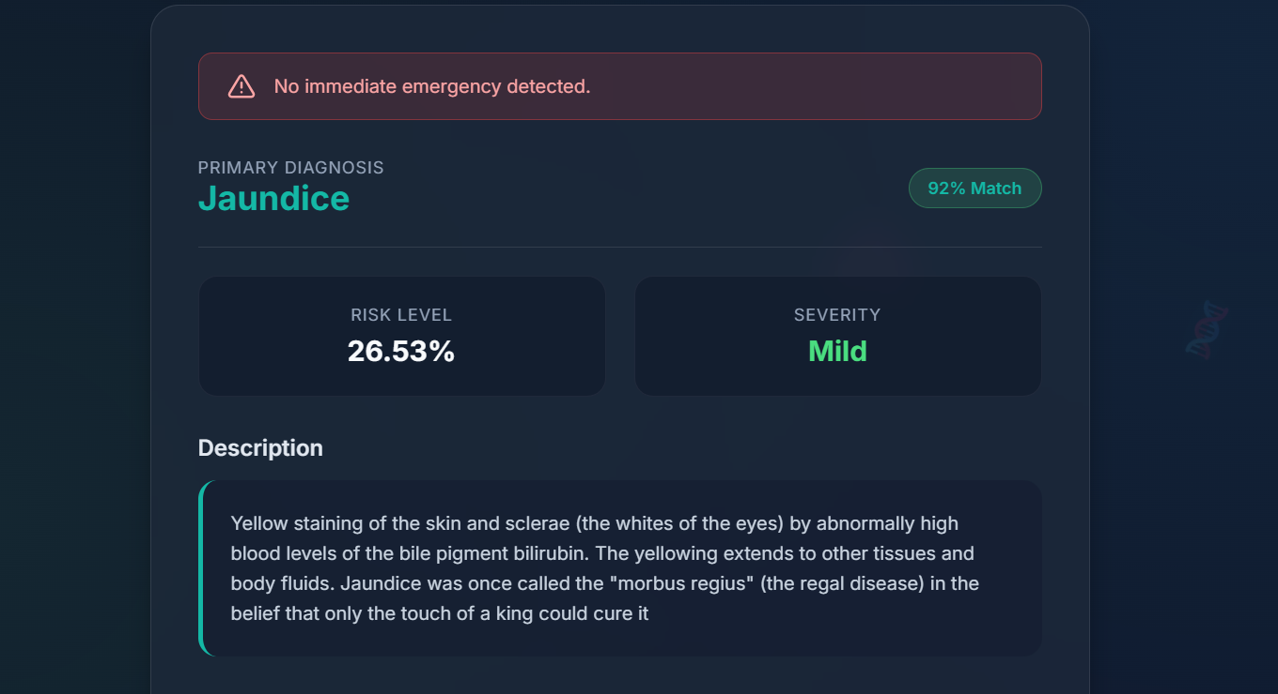
SAMPLE IMAGES

Slide 15
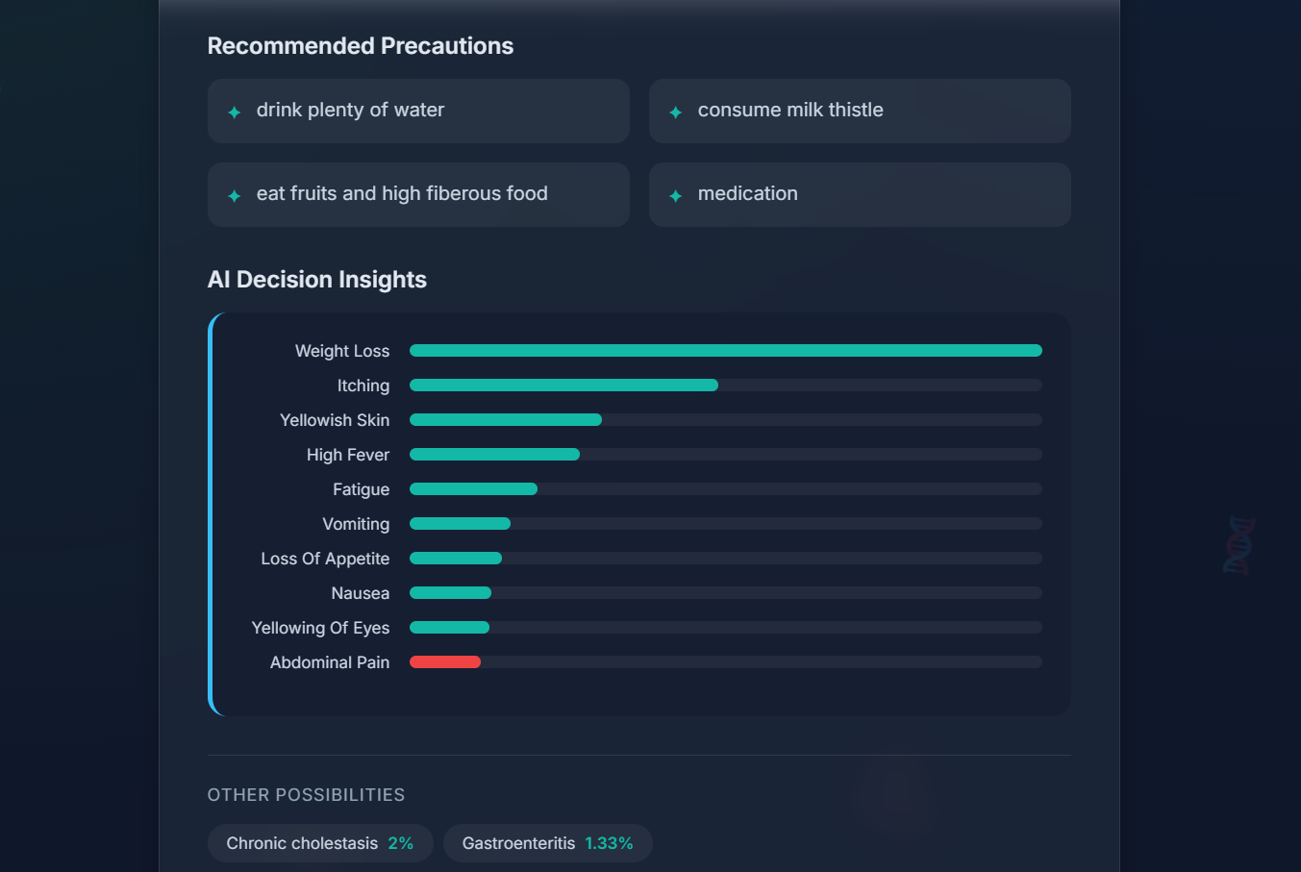
SAMPLE IMAGES

Slide 16
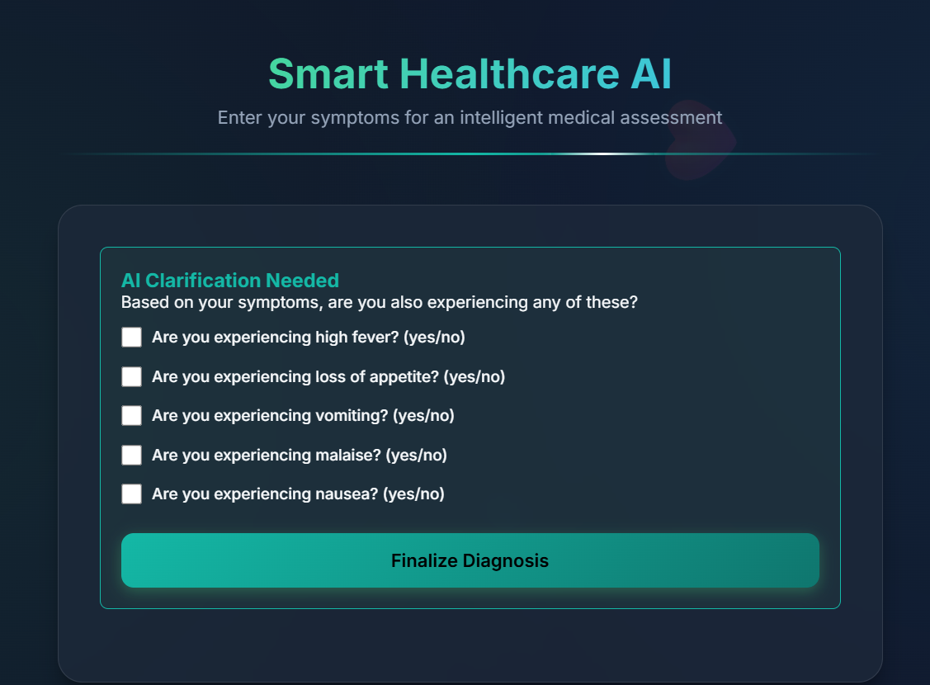
SAMPLE IMAGES

Slide 17
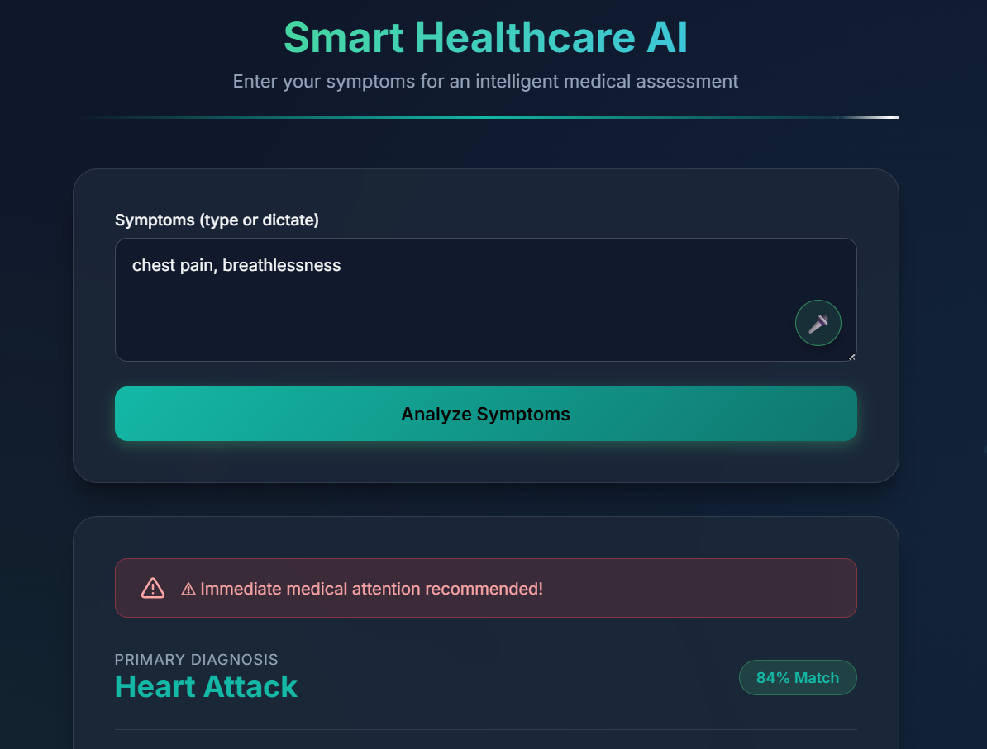
SAMPLE IMAGES

Slide 18
SAMPLE IMAGES

Slide 19
SAMPLE IMAGES

Slide 20
SAMPLE IMAGES

Slide 21
SAMPLE IMAGES

Slide 22
SAMPLE IMAGES

Slide 23
SAMPLE IMAGES

Slide 24
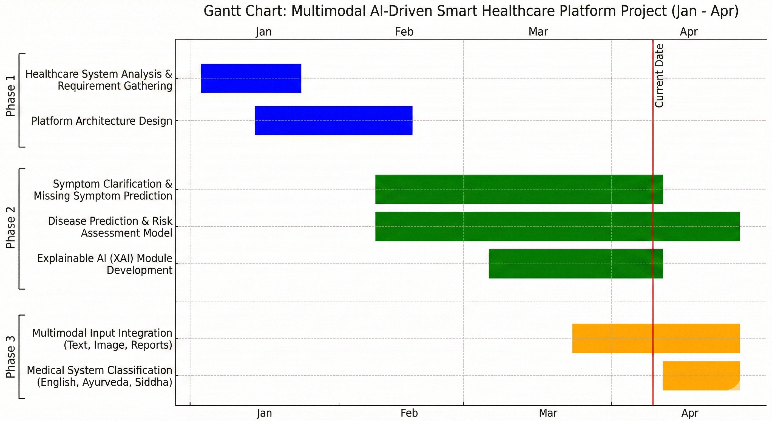
GANTT CHART

Slide 25
CONCLUSION
This platform transforms the digital healthcare experience by enabling voice-based symptom input combined with Explainable AI for accurate and user-friendly diagnosis. It enhances trust, safety, and accessibility by providing transparent results and real-time emergency alerts. The system is fully developed, tested, and designed for scalability, with future potential for nationwide deployment, including live doctor consultations and lab integration.

Slide 26
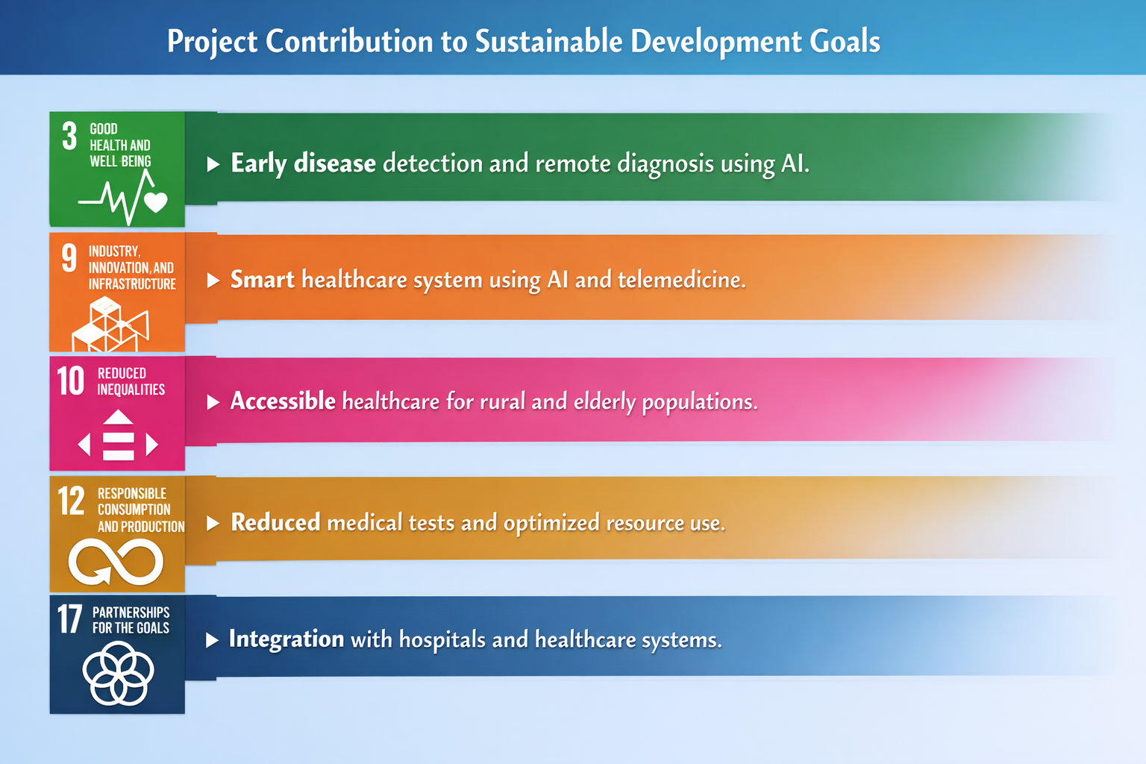
SUSTAINABLE DEVELOPMENT GOALS

Slide 27
IEEE REFERENCES
[1] Andre Esteva, B. Kuprel, R. A. Novoa, et al., “Dermatologist-level classification of skin cancer with deep neural networks,” Nature, vol. 542, no. 7639, pp. 115–118, 2017.
[2] Olaf Ronneberger, P. Fischer, and T. Brox, “U-Net: Convolutional Networks for Biomedical Image Segmentation,” in Proc. MICCAI, 2015, pp. 234–241.
[3] Karen Simonyan and Andrew Zisserman, “Very Deep Convolutional Networks for Large-Scale Image Recognition,” in Proc. ICLR, 2015.
[4] Diederik P. Kingma and Jimmy Ba, “Adam: A Method for Stochastic Optimization,” in Proc. ICLR, 2015.
[5] Ramprasaath R. Selvaraju, M. Cogswell, A. Das, et al., “Grad-CAM: Visual Explanations from Deep Networks via Gradient-Based Localization,” in Proc. ICCV, 2017, pp. 618–626.
[6] World Health Organization, “Telemedicine: Opportunities and Developments in Member States,” WHO Press, Geneva, Switzerland, 2010.
[7] Geoffrey Hinton, L. Deng, D. Yu, et al., “Deep Neural Networks for Acoustic Modeling in Speech Recognition,” IEEE Signal Processing Magazine, vol. 29, no. 6, pp. 82–97, 2012.
[8] Ashish Vaswani, N. Shazeer, N. Parmar, et al., “Attention Is All You Need,” in Proc. NeurIPS, 2017, pp. 5998–6008.
[9] Rich Caruana, Y. Lou, J. Gehrke, and G. Koch, “Intelligible Models for Healthcare: Predicting Pneumonia Risk and Hospital 30- Day Readmission,” in Proc. KDD, 2015, pp. 1721–1730.
[10] Eric Topol, “High-performance medicine: the convergence of human and artificial intelligence,” Nature Medicine, vol. 25, pp. 44–56, 2019.

Slide 28

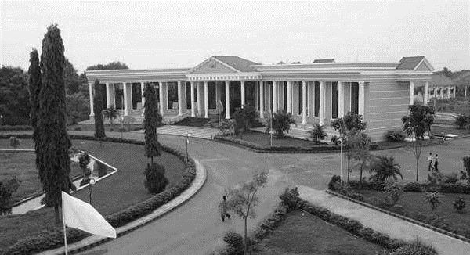
THANK YOU
DEPARTMENT OF IT

